Slide 1
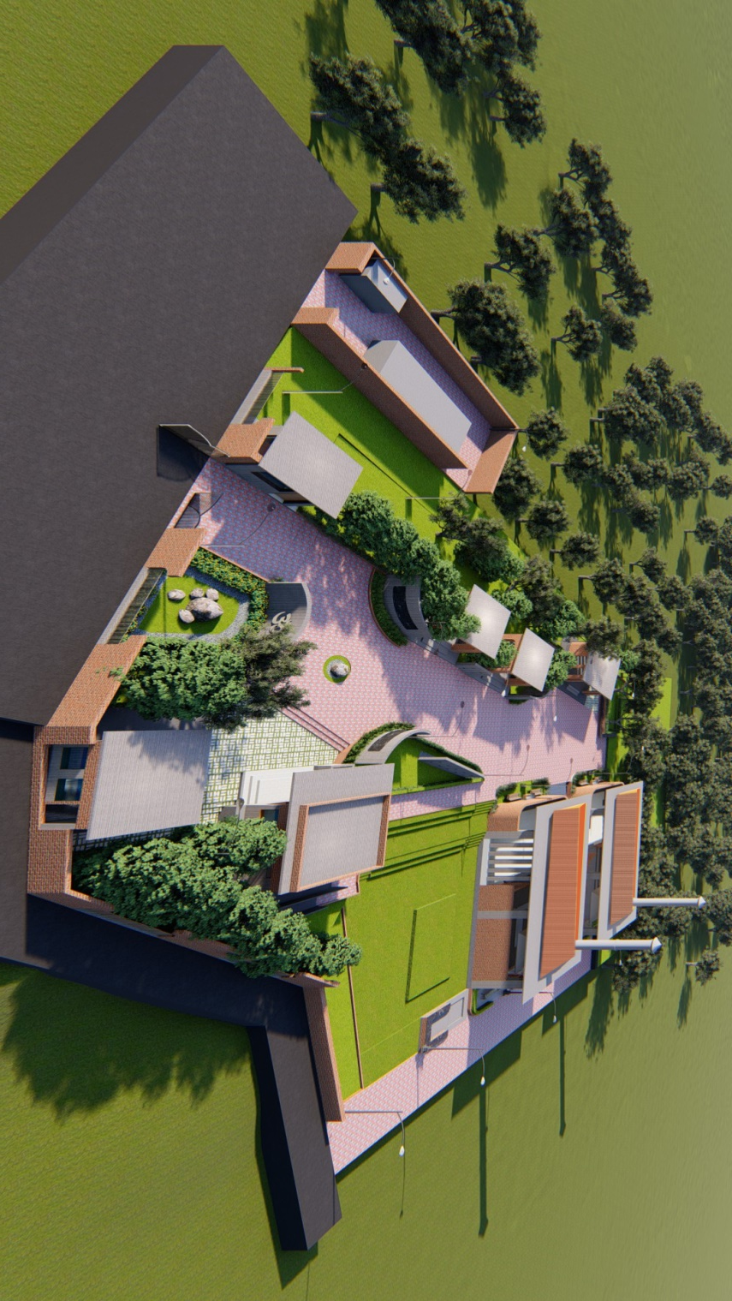
SITE VIEW
Notes:
SITE VIEW

Slide 2
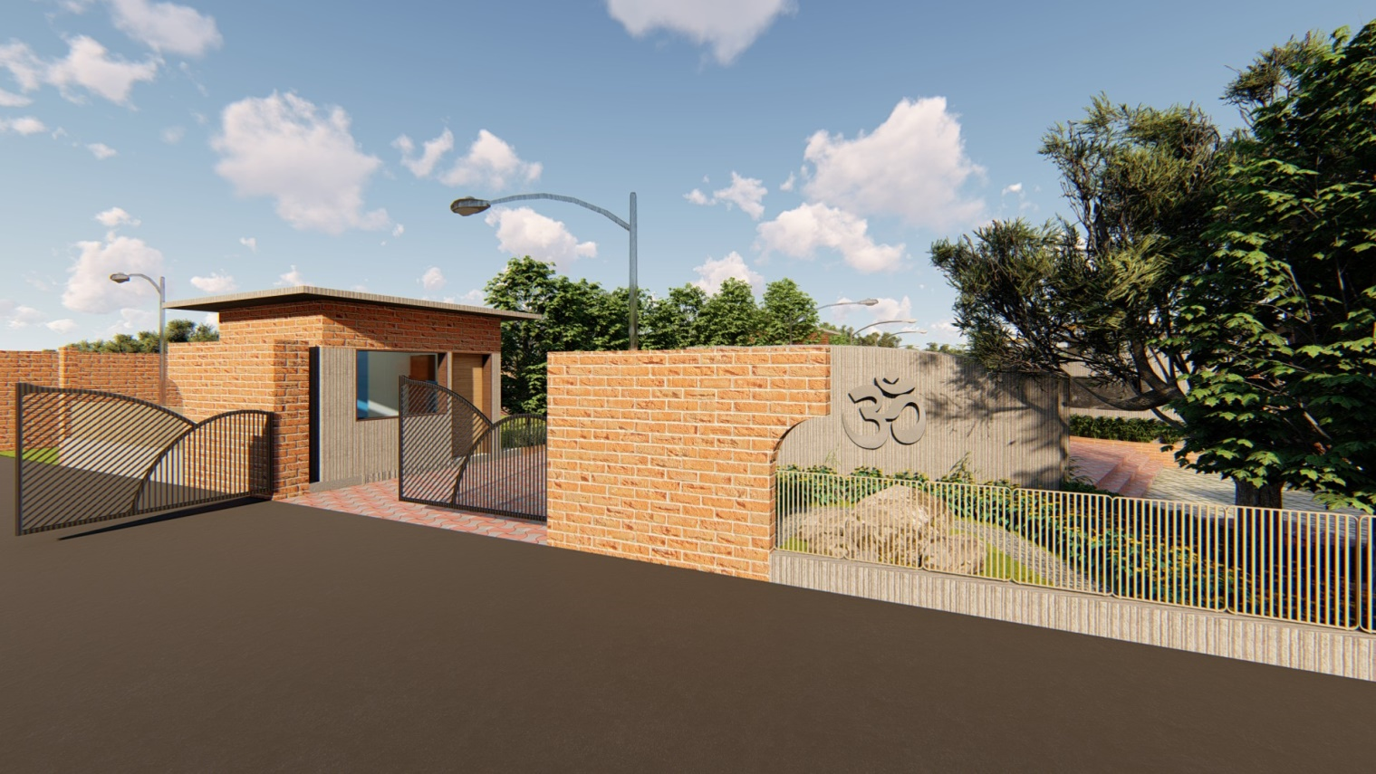

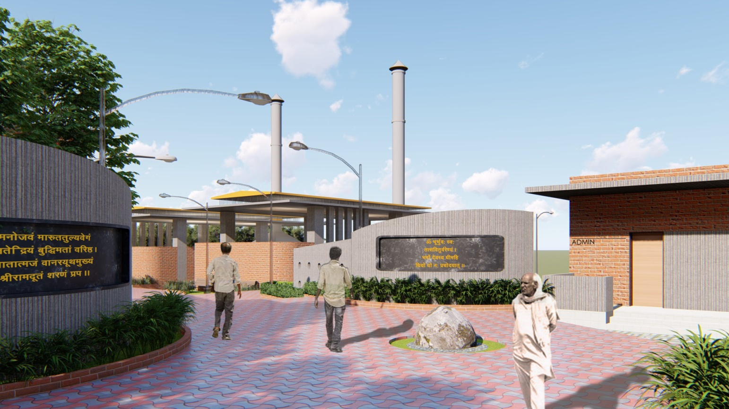
ENTRY GATE
ENTRY VIEW 2

Slide 3
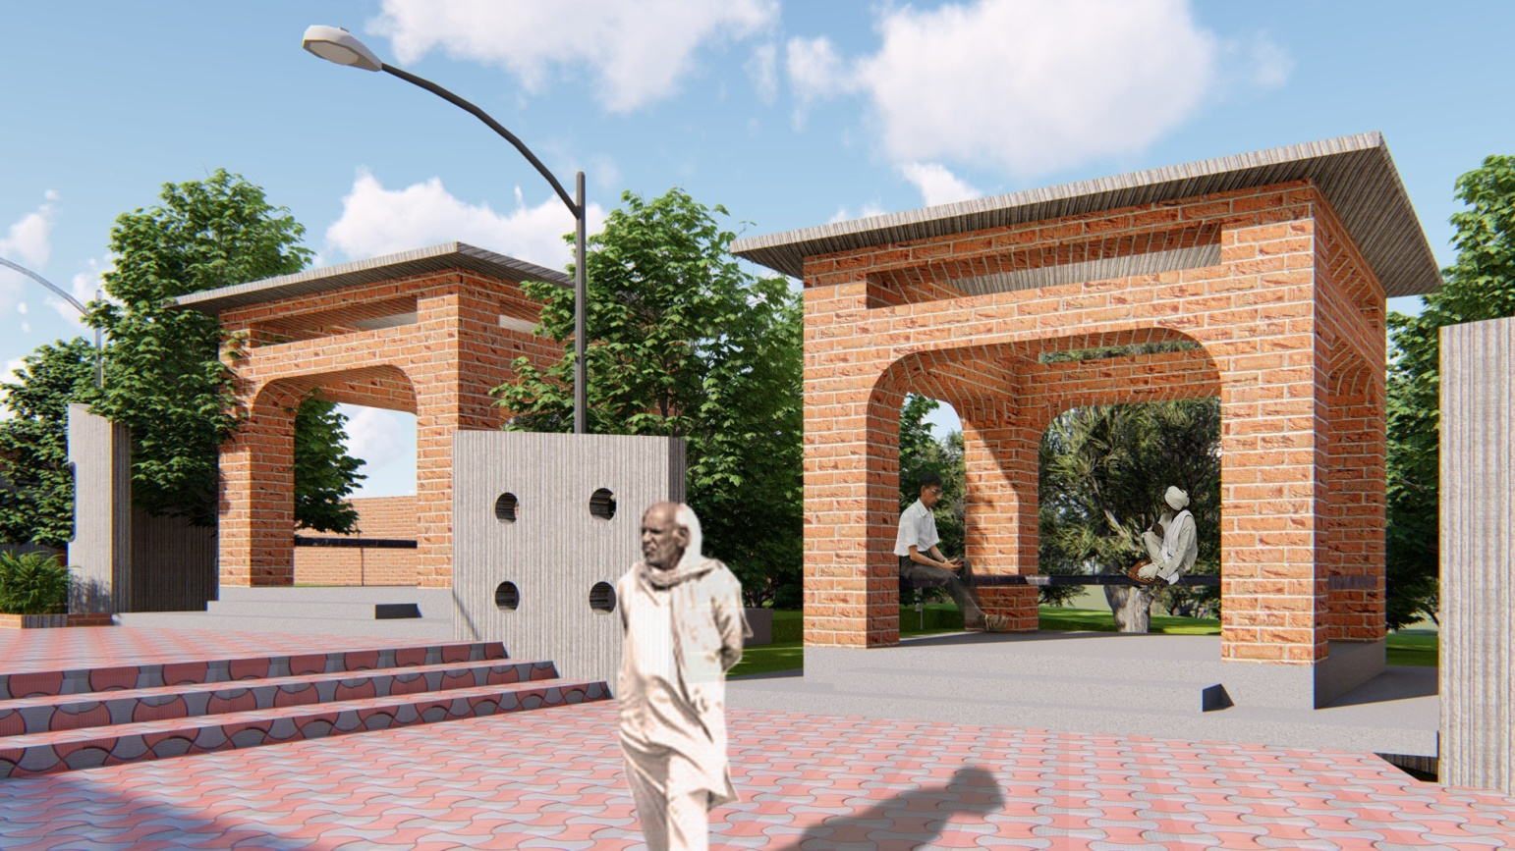
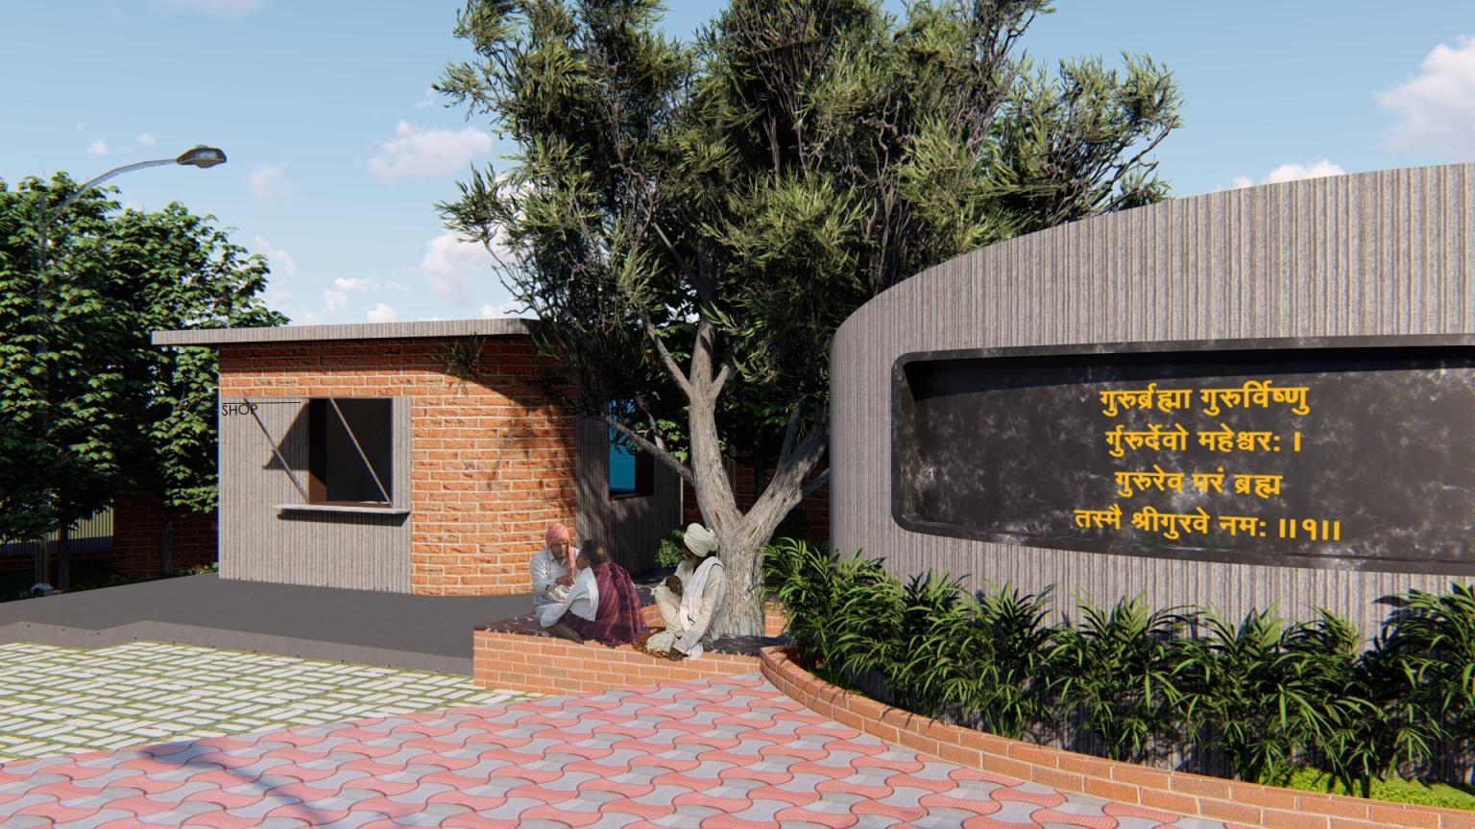

GAZEBOS
SHOP VIEW

Slide 4
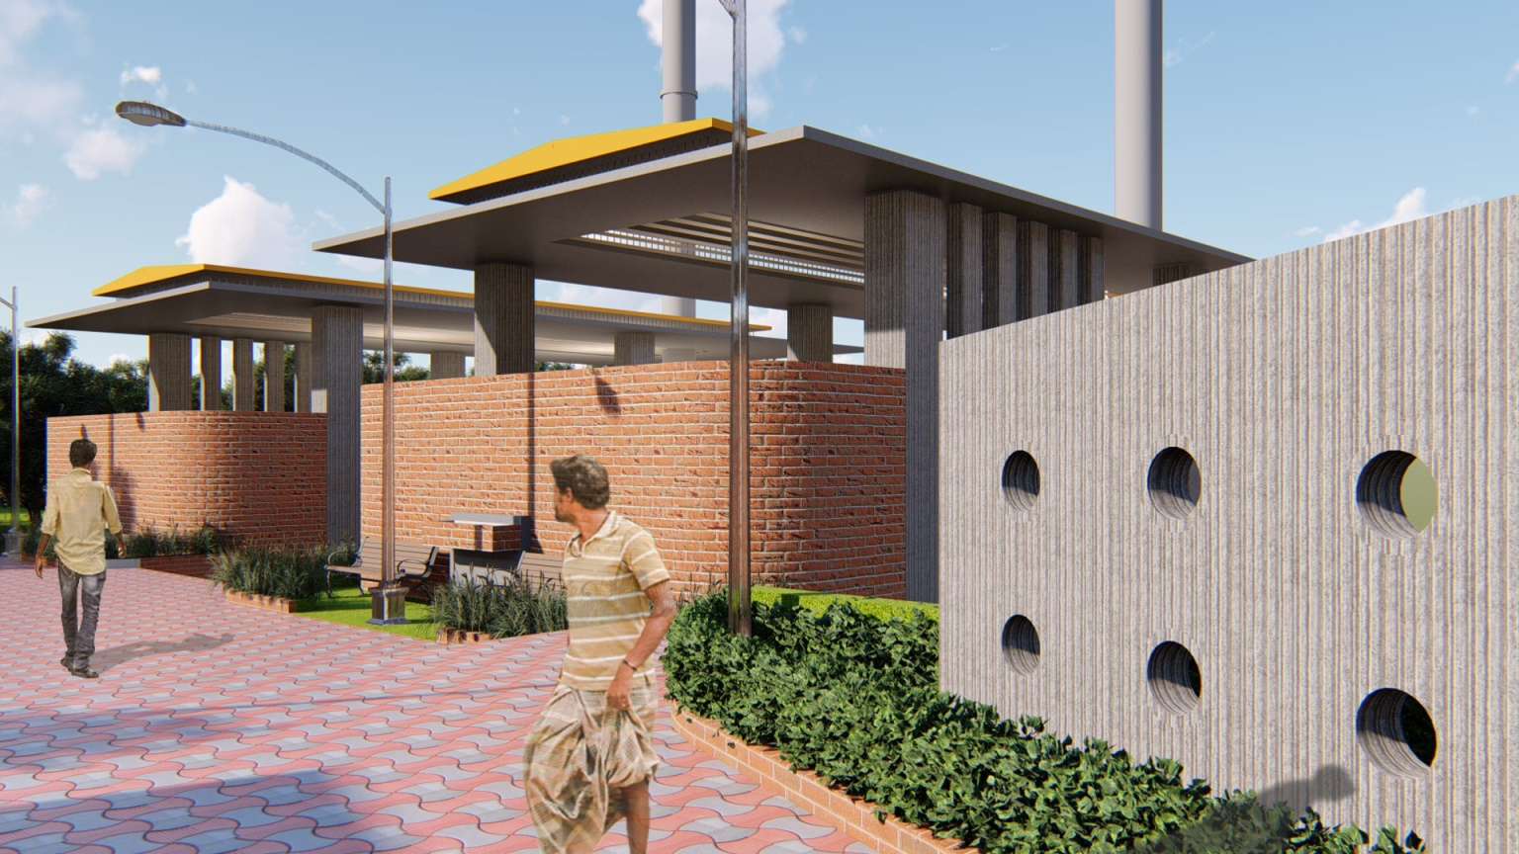
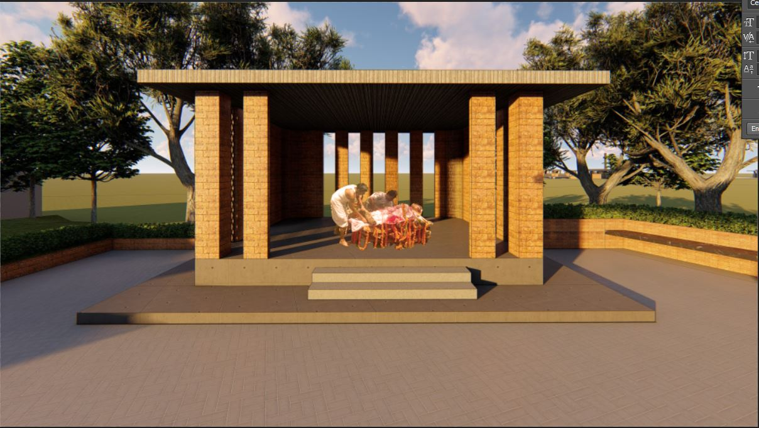
CREMATORIUM VIEW
RITUAL PLACE

